Slide 1
Name: Md. Shamsul Alam Momin ID: 171-019-042 Course Code: CSE 325 Course title: Compiler Design Subject: Final Presentation Topic: Compiler Construction
Topics to be discussed:
What is Compiler?
Programming Languages vs Formal Languages?
Regular Expressions and Automata Theory
Applications

Slide 2
Compiler:
What is a compiler:
Compiler: The language processor that reads the complete source program written in high level programming language as a whole in one go and translates it in equivalent program in machine language is called a compiler. Example: C, C++, Java etc.
Source Code
Compiler
Target Code

Slide 3
Programming Language vs Formal Language:
The language, which we use for communication, is called the formal language.
On the other hand, to communicate with the computer we use programming languages.
Computer works based on instruction and we give instruction to the computer by using different programming languages.

Slide 4
Some application of Regular Expression and Finite Automata:
Web Programming
Pattern Matching Situations
Editors and word processors

Slide 5
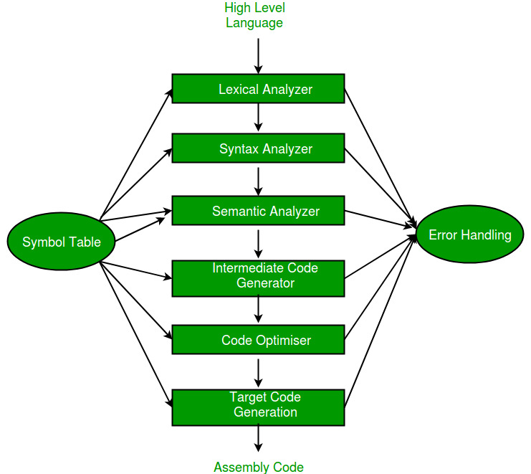
Translation Flow of a compiler:

Slide 6
Components of a compiler:
Components of a compiler are:
Lexical Analysis
Syntax Analysis
Semantic Analysis
Intermediate Code Generation
Code Optimization
Code Generation

Slide 7
Flow Chart of how a compiler works
T
Source Code
Scanner
Parser
Semantic Analyzer
Source Code Analyzer
Code Generation
Code Optimizer
Target Code

Slide 8
Lexical Analysis:
Lexical analysis is the first phase of a compiler.
It takes the modified source code from language preprocessors that are written in the form of sentences.
The lexical analyzer breaks these syntaxes into a series of tokens, by removing any whitespace or comments in the source code.
Example of Lexical Analysis is let’s say we have an expression like this:
Int x=50;
Here each word used in this expression (i.e. int, x, =, 50) are known as tokens. Lexical Analysis breaks the expressions into tokens and check for if there is any error found.
If the lexical analyzer finds a token invalid, it generates an error. The lexical analyzer works closely with the syntax analyzer. It reads character streams from the source code, checks for legal tokens, and passes the data to the syntax analyzer when it demands.
The lexical analysis forms tokens from an expression in the following way:
Let us consider an expression x=y+z
Now the lexical analysis phase represent the expression like this:
<id,1> < = > <id,2> <+> <id,3>

Slide 9
Syntax Analysis:
Syntax analysis or parsing is the second phase of a compiler.
It takes the list of tokens produced by the lexical analysis and arranges these in a tree-structure
This tree is called the syntax tree.

Slide 10
Example of Syntax Analysis:
Y=X*50
Expression
Assign Expression
Assign Expression
Additive Expression
Expression
Expression
*
Expression
Number
=
X
50
Y

Slide 11
Semantic Analysis:
Semantic analysis is the task of ensuring that the declarations and statements of a program are semantically correct, i.e. that their meaning is clear and consistent with the way in which control structures and data types are supposed to be used.
Works with the logical part of a program.
The semantic analyzer keeps track of identifiers, their types and expressions; whether identifiers are declared before use or not.
The semantic analyzer produces an annotated syntax tree as an output.

Slide 12
Example of Semantic Analyzer
Y=10*10
Assign Expression
Subscript Expression
Additive Expression
Identifier(Y)
Identifier Index
Number(10)
Number(10)

Slide 13
Intermediate Code Generator:
Generates Intermediate codes
The program is translated into a simple machine independent intermediate language.
Generates three address code which consists maximum 3 operands and 2 operator.
Creates temporary variable
For example for the expression x=y+30 the three address code can be written as:
t1=30
T2=y
T3=t1+t2
X=t3

Slide 14
Code Optimization:
In this phase of compiler, the intermediate code generator is updated. That means, this phase minimize/reduce the steps of the previous step to give faster running machine code.
The output code must not, in any way, change the meaning of the program.
Optimization should increase the speed of the program.
Optimization should itself be fast and should not delay the overall compiling process.
Now let’s see how the code optimization phase minimize the steps of the intermediate code generator phase.
To test this the same example will be considered. So we will consider the expression x=y+30 as usual.
Now in code optimization phase this expression can be represented very easily compare to the previous phase by this way:
t1=30
t2=y
x=t1+t2
So as we can see the steps has been reduced. And this phase exactly do this task!!!!

Slide 15
Code Generation:
The target code is generated in this phase.
The intermediate language is translated to target code or assembly language.
This is the last phase before the target code has created.

Slide 16
Algorithmic tools:
This term is also known as compiler construction tools.
These tools uses specific language or algorithm for specifying and implementing the components of the compiler.
Some type of algorithmic tools are: tokens, scanners, parser, code generator etc.
Tokens uses the regular expressions.
Scanner implement Finite State Machine (FSM) to recognize tokens.
Parser uses a stack to based on grammar rules on a standard formats.
Semantic analysis looks for logical errors and solves them if possible and code generator build up the target code.

Slide 17
Dependency of the compiler phases:
Scanner, parser, semantic analyzer and source code optimizer depend primarily on the source language.
On the other hand, code generator and target code optimizer depends primarily on the target language.

Slide 18
Error handling or error management:
Error handling or error management is one of the most difficult part of a compiler to design
This is a type of measurement of the compiler efficiency and how perfect a compiler is.
To be a good compiler a compiler must have the ability to handle the errors.
The compiler that handles more error is better than other compiler that handles less error.
To be a good compiler a compiler
Must handle multiple errors.
Must handle a wide range of errors.
Must not get stuck.
Must not get into an infinite loop.

Slide 19
Kinds of errors:
While compiling a program we generally find 3 types of errors. They are:-
Syntax error: In this type of error the value of a variable is not define clearly.
For example the expression
if (a==1)
Y=z+r:
This expression has syntax error. As the values of Y, z, r are not defined clearly.

Slide 20
2. Semantic Error: This leads to the logical error of a program. Let us consider an example.
Let us consider the expression int a=“ab”. Now, in this expression we find semantic error. Because “ab” is not a number. So it is not an integer type variable. But in this example “ab” is defined as an integer variable. So this is a semantic error.
3. Runtime Error: Sometimes a program ends up with an infinite loop or the compiler don’t know about where it has to be stop. In this case the runtime error (that is error in runtime) occurs.
Let us consider some expression of a program:-
int x=1, y=0
int z=x/y;
printf(“z=%d“ z);
Here x/y means 1/0 which is undefined. So in the runtime the compiler can understand the error. So this type of program is known as runtime error.

Slide 21
Error Handling Requirement:
A general compiler must have to handle the syntax error as well as the semantic errors.
If a compiler cannot do this action (Error Handling) then this is of no use.
Sometimes, some compiler itself is required to generated code to handle the runtime errors in some graceful way. The java compiler is an example of this type of compiler. This too, is often very difficult.

Slide 22
Some example of sample compiler:
Tiny C compiler:
Support Linux, UNIX and Microsoft Windows Operating System.
Written for C, assembly language.
Created by Fabric Bellard.
Example code of a tiny compiler:
read a;
If a>0 then
fact : 1;
Repeat
fact : fact * x;
x: x - 1;
until x= 0;
write fact;
End;

Slide 23
2. Java compiler:
Compiles the Java programming language.
The most common form of output from a Java compiler is Java class files containing platform-neutral Java byte code.
The Java Virtual Machine (JVM) loads the class files and either interpretes the bytecode or Just-In-Time (JIT) compiles it to machine code and then possibly optimizes it using dynamic compilation. The term dynamic compilation is a process used by some programming language to gain performance during program execution.

Slide 24
Example code for a java compiler:
import java.util.Scanner;
public class AddTwoNumbers2 {
public static void main(String[] args) {
int num1, num2, sum;
Scanner sc = new Scanner(System.in);
System.out.println("Enter Two Number: ");
num1 = sc.nextInt();
num2 = sc.nextInt();
sum = num1 + num2;
System.out.println("Sum of these numbers: "+sum);
}
}

Slide 25
Conditional Compilation Options:
Sometimes a compiler is build up with some options or criteria or conditions. This type of Compiler is known as Conditional Compiler. Conditional compiler can be created with many options.
Some kind of conditional compilation options are:-
No_Parse: Builds a compiler with the scanner only but no parsing will be done in this.
No_Analyze: Builds a compiler that only can parse and scan. But cannot analyze the source code.
No_Code: Builds a compiler that performs semantic analysis, but no code is generated.

Slide 26
List options or built-in options in compiler:
Some options are built-in for any type of compiler. For example:-
Echosource: Performs the tiny source programs to the listing, together with line numbers.
TraceScan: Displays the information of tokens as the scanner recognize it.
TraceParse: Displays the syntax tree in a linearlized format.
TraceAnalyze: Displays summary information on the symbol table and type checking.
TraceCode: Prints code generation-tracing comments to the code file.

Slide 27
Porting and Bootstrapping in Compiler Design:
On the other hand porting in compiler design refers to adding new features or newly created attribute to a compiler that does not exist before or in old version.
That means porting in compiler design is nothing but creating a compiler with updated and new features that has not applied before or has not applied in the previous or old versions.

Slide 28
On the other hand, Bootstrapping is used to produce a self-hosting compiler. Self-hosting compiler is a type of compiler that can compile its own source code. Bootstrap compiler is used to compile the compiler and then you can use this compiled compiler to compile everything else as well as future versions of itself.
That means after Bootstrapping the compiler can compile its own source code.
It is a very fantastic feature to add for creating new compiler so that nothing will be needed to compile the source code instead the compiler itself can compile the source code directly.
So it can be said that Bootstrapping is a type of porting.

Slide 29
T diagrams:
T diagrams is used in bootstrapping.
1. Suppose we have cross-compiler for a new language L in implementation language S generating code for machine N.

Slide 30

LSN:

Slide 31
2. Suppose we also have an existing S compiler running on machine M implementing code for machine M:

Slide 32

SMN:

Slide 33
3. Run LSN through SMN to produce LMM.
Compiler Construction:
LMN= LSN + SMM

Slide 34
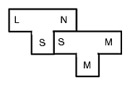

Slide 35
Here the first T describes a compiler from L to N written in S.
The second T describes a compiler from S to M written in M (or running on M). This will be your compiler compiler.
Applying the second T to the first T compiles the first T so that it runs on machine M. The result is thus a compiler from L to N running on machine M.
The fact that the second T also runs on machine M is captures that you are running the compiler compiler on the machine which you will run the compiler, rather than having to use a cross compiler (which would be the case if the bottom M were different).

